Slide 1
Copyright and Social Media
August 25, 2021

Slide 2
Copyright: When do I care?

Slide 3
QUESTIONS TO ASK
When was it created?
What type of work is it?
Who created it?

Slide 4
WHEN WAS IT CREATED?
Before 1925:
Between 1925 & 1978:
On or after 1978:
Initial Term:
Publication with Notice
Public Domain
Renewal Term:
Either register with Office OR Automatic
Automatic:
Original Work of Authorship Fixed
Past Initial Term, No Renewal?
Public Domain

Slide 5
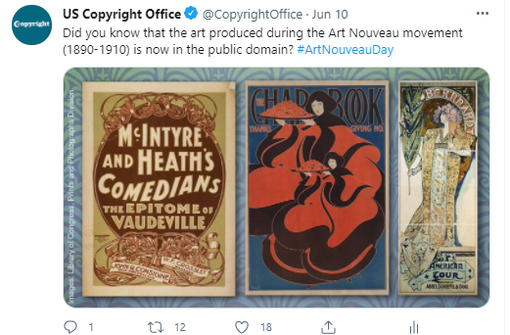
Public Domain Usage
No copyright concerns
Connect past to current events

Slide 6
WHAT ARE “WORKS”?
Literary works
Blog and social media posts, news articles, website copy
Musical works including accompanying lyrics
Online sheet music, streamed music
Dramatic works
Pantomimes and choreographic works
Pictorial, graphic, and sculptural works
Photographs, website graphics, drawings
Motion pictures and other audiovisual works
YouTube, TikTok, some gifs, Snapchats, and Instagram stories
Sound recordings
Streamed music
Architectural works

Slide 7
WHAT TYPE OF WORK IS IT?
Independent creation (it was NOT copied from somewhere else)
It is “creative”
The bar is a LOW – you only need a “modicum” of creativity
But there IS a bar
No protection for simple geometric shapes, short phrases or slogans, titles or names, familiar symbols or designs, mere listings of ingredients or contents, fonts, and more
Effort, novelty, attractiveness, symbolism, or author intent do NOT matter

Slide 8
WHAT ARE NOT WORKS?
Ideas
Procedures
Processes
Systems
Methods of Operation
Concepts
Principles
Discoveries

Slide 9
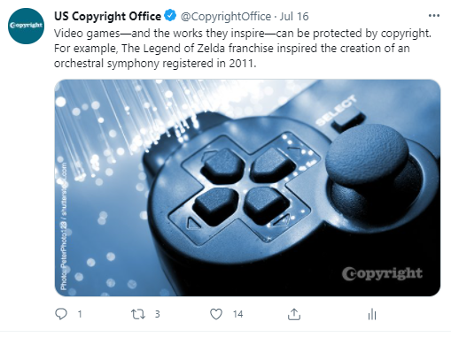
Licensed Images
Permission legally clear
Tailor images to mission

Slide 10
WHO CREATED IT: GOVERNMENT WORKS
Copyright protection is not available for any work of the United States Government . . .
A “work of the United States Government” is a work prepared by an officer or employee of the United States Government as part of that person’s official duties.

Slide 11
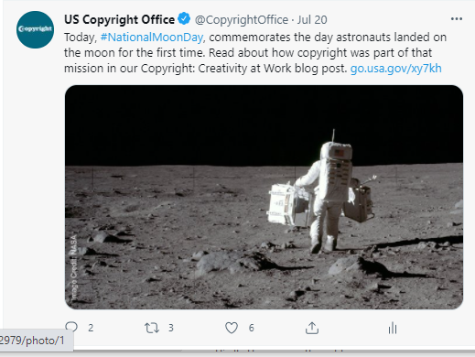
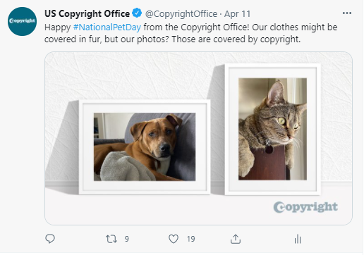
US Government Works and Employees
Yes!
No!

Slide 12
Fair Use: How do I use it?

Slide 13

Exclusive Rights are Subject to Limitations
Statute sets out specific situations, such as:
Face-to-face teaching
Formal online teaching
Selling or disposing a physical copy
Streaming and distributing music
Today, we’ll focus on one of the most popular:
Fair use

Slide 14
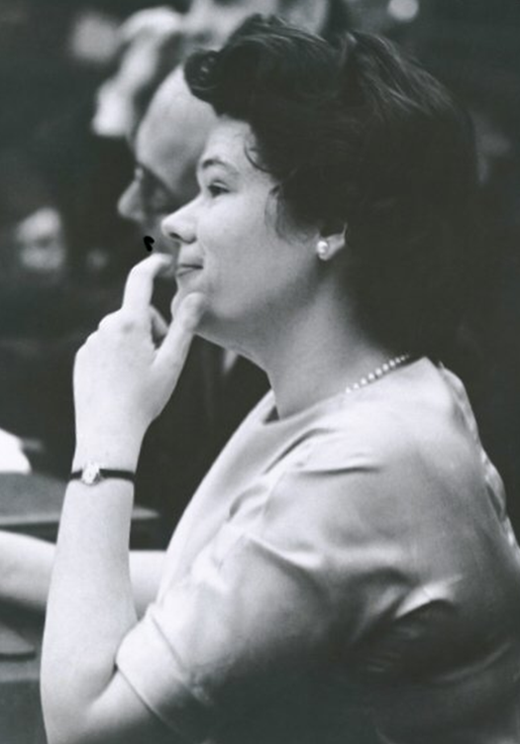
SECTION 107 FOUR FACTORS
In determining whether the use made of a work in any particular case is a fair use the factors to be considered shall include –
The purpose and character of the use, including whether such us is of a commercial nature or is for nonprofit educational purposes
The nature of the copyrighted work
The amount and substantiality of the portion used in relation to the copyrighted work as a whole; and
The effect of the use upon the potential market for or value of the copyrighted work.

Slide 15
FAIR USE: YOUR MILEAGE MAY VARY
Fair use is determined on a case-by-case basis
Why am I using the work?
What am I adding to the work?
Does my use change the meaning of the work?
How much am I using the work?
What type of work is this? Mostly factual? Highly creative?
Does my use replace a usual licensing stream or otherwise affect the owner’s market?
Fair use final determination is made by a court
Risk involved
As a result: what level of risk is involved in any particular use, and what does my institution think about it?

Slide 16
Creative Commons: How does it work?

Slide 17
LEGAL STRUCTURE FOR CREATIVE COMMONS
Copyright owners have the ability to engage in or to authorize the exclusive rights in Section 106: reproduce, distribute, adapt, publicly perform, publicly display
“Authorization” = license
VERY BROAD!
Copyright owners have flexibility to grant permission under wide range of conditions
Creative commons is a public license
Non-exclusive
Copyright still present – you’re invited to use/remix/share
Standard template for copyright owners to apply to their works
Owner grants to the general public the right to use the work
Can be unrestricted or can be restricted by type of use and specifications on attribution

Slide 18
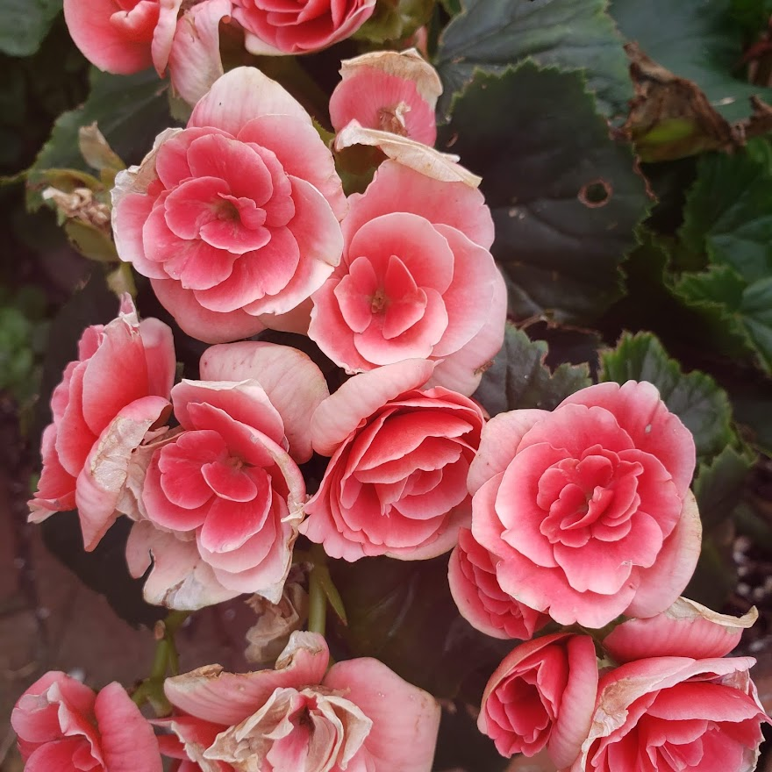
The Flow
The
Terms
The
License
The
Use
(c) Whitney Levandusky 2021,
CC BY-NC-SA 4.0, no modifications

Slide 19
Memes: Where do they come from?

Slide 20
ARE MEMES PROTECTED BY COPYRIGHT? SOMETIMES NO.
Copyright Concepts at play:
Words and short phrases
Ideas
Public domain material
Works before 1925
Works that fell out of protection
U.S. Government works
Examples:
“TIL . . .”
“My fall plans / the delta variant”
#winning

Slide 21
ARE MEMES PROTECTED BY COPYRIGHT? SOMETIMES YES.
Copyright Concepts at Play:
Automatic protection
Author has ability to authorize
Social media – what permissions?
Excerpts are equally protected as the whole
Examples
Check your source!

Slide 22
Resources: Where do I find information?

Slide 23
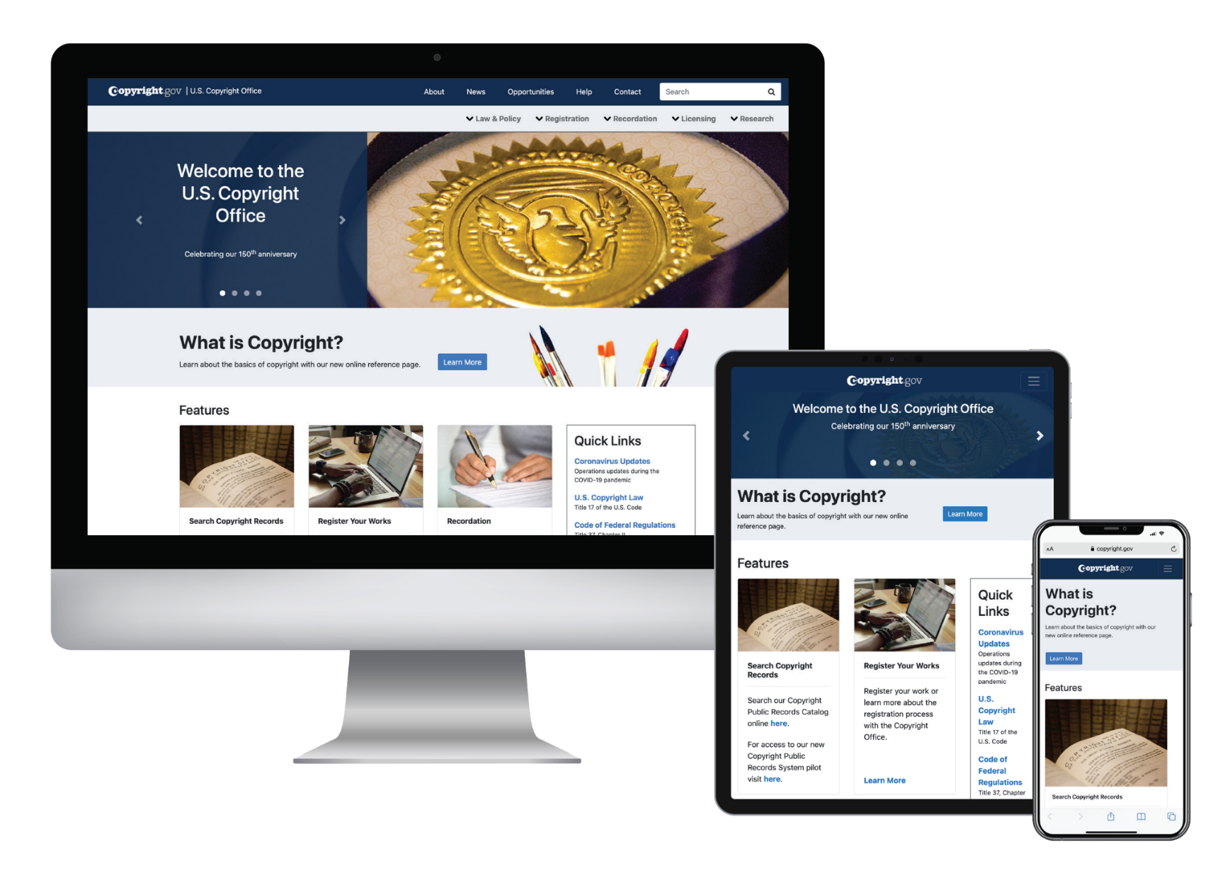

Online Resources

